Slide 1
Strategic Change Plan For McDonald’s
Pranali Lad –P2744307
Vinay Pareek -P2778430
Vandana Karippal Rajeev-P2774295
Ajo Jose –P2778727
Muhammed Ijas –P2773890
Cristo Santhosh-P2778632
Basil peter-P2780840
Notes:
Title

Slide 2
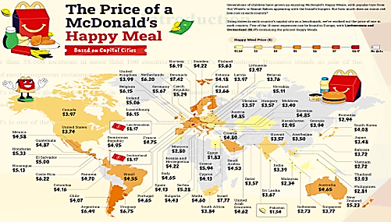
Introduction
With more than 38,000 locations in more than 100 countries, McDonald's International Business stands as one of the biggest and most prosperous restaurant companies in the world.
McDonald's started its global development in 1967 with the establishment of its first restaurant in Canada. The company was founded in San Bernardino, California, in 1940.
McDonald's is one of the most well-known brands in the world today, and millions of people visit its locations everyday.
Notes:
Three segments make up McDonald's global business: Europe, International Developed Markets (IDM), and High Growth Markets (HGM). With more than 40% of McDonald's foreign income coming from this area, Europe is the largest. Among the nations in the IDM category are South Korea, Japan, and Australia. The HGM group include nations including Russia, China, and India. McDonald's international businesses have encountered several obstacles lately, such as diminishing revenues in its developed areas, heightened rivalry from fast-casual and ethnic dining establishments, and evolving customer inclinations.

Slide 3
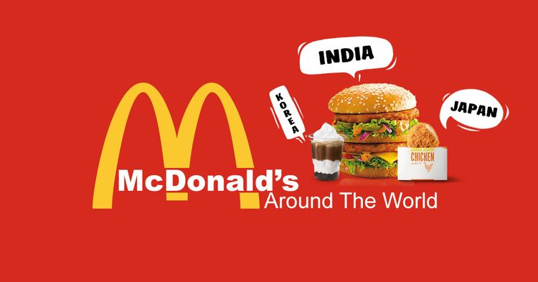
Contd
McDonald's has, nonetheless, made a number of changes to its eateries, added more delivery alternatives, and improved its menu to address these issues.
A significant portion of McDonald's entire business is its overseas operations.
Notes:
Over $27 billion in sales was made by McDonald's overseas operations in 2022, making up more than 60% of the company's overall revenue. McDonald's intends to establish more than 1,800 new restaurants in foreign regions in 2023 as part of its commitment to expanding its global business.

Slide 4
Strategic Audit
PESTEL for External Analysis
Political | Government rules pertaining to labour, the environment, health and safety, and other issues are all applicable to McDonald's.
Economic | Consumer spending may rise as a result of economic expansion, which would be advantageous for McDonald's (Tien et al. 2020).
Social | Concerns about sustainability are growing among consumers.
Technological | New food technology has the potential to enhance McDonald's offerings and business processes.
Environmental | The operations and supply chain of McDonald's may be impacted by climate change.
Legal | In the food sector, adherence to health and safety requirements is crucial.
Notes:
Modifications to these rules may affect the expenses and business operations of McDonald's. Trade regulations, such as tariffs and quotas, may have an effect on the pricing of McDonald's goods and the cost of its components. Expenses associated with inflation, such as labour and ingredient expenses, may go up for McDonald's. A decrease in customer spending may have a negative impact on McDonald's sales. Modern point-of-sale systems can help McDonald's boost productivity and enhance the customer experience.

Slide 5
Contd
SWOT for Internal Analysis
Strengths | Weaknesses | Opportunities | Threats
Having one of the most recognisable and famous brands in the world, McDonald's has a big competitive edge. | The growing consciousness among consumers about health and nutrition has resulted in critiques of McDonald's menu, citing excessive amounts of calories, salt, and unwholesome components. | To satisfy this desire, McDonald's may provide more options and healthier substitutes to its menu. | The conventional menu and business model of McDonald's may be put to the test by shifting consumer tastes for food that is healthier and supplied more ethically (Halawa, and Parasecoli, 2019).
Notes:
The company's cost-effective operations and consistent product quality are made possible by its standardised procedures, effective supply chain, and franchising model. To accommodate a range of consumer tastes and dietary needs, McDonald's provides a large selection of menu options. McDonald's may still have few options for consumers looking for healthier or more distinctive selections while having a wide variety of menu items. The fast-food industry's fierce rivalry may put pressure on prices and necessitate ongoing innovation in order to stand out.

Slide 6
Strategic Change Options
Give emerging markets priority: McDonald’s may concentrate on growing its business in developing nations like Southeast Asia, China and India.
Menu diversification: McDonald’s may provide more individualised and healthful alternatives on its menu such as salads and fruits to innovate (Burton and Smith, 2020).
Enhance the customer’s experience: McDonald's may enhance the experience of its patrons by renovating its eateries, providing more individualised care, and growing its delivery network.
Targeting health conscious customers: The food products of McDonald’s are tasty yet unhealthy. Considering this, adding healthy food options and targeting health conscious customers, which is increasing day by day, will be beneficial for the company.
Notes:
These markets have tremendous development potential because of their sizable and expanding populations and rising levels of disposable income. McDonald's might have to make investments in restaurant construction in these markets to be able to carry out these options. McDonald's must spend money updating and modernising its eateries in order to put this option through action. About 60% of global customers are health conscious and that indicates the company might target a large number of population worldwide by adding salads and fruit options to their menu (Dsm, 2022). The business can furthermore concentrate on fostering connections between customers on social media. McDonald's has to enhance its marketing and advertising budget in order to put this plan into action. Additionally, the business might create social media campaigns to interact with clients and foster brand loyalty.

Slide 7
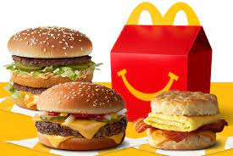
Evaluation of Strategic Change Options
McDonald's must focus on expanding its menu and enhancing the customer experience, according to the strategic audit and the four strategic change choices that were offered.
Creating new goods and menu items that are healthier, more individualised, and more in line with regional cultures and trends can be part of the process of innovating the menu (Raheem et al. 2019).
Notes:
The best choices for McDonald's global operations are these two ones as they can allow the corporation to adapt to the shifting demands and tastes of its clientele while remaining practical and well-liked by shareholders and management. This can help McDonald's in bringing in new business and keeping hold of current clientele. It is intended to renovate restaurants, provide more individualised service, and increase delivery options to improve the consumer experience. This allows McDonald's to give patrons a more contemporary and welcoming eating environment

Slide 8
Chosen Strategic Option
The menu's innovation and enhanced customer experience have been selected as the strategic options.
McDonald's is going to add fruits and salads options to their menu that are more individualised, healthful, and in line with regional customs and trends in order to reinvent its offerings (Halawa and Parasecoli, 2019).
This strategic shift plan's implementation is going to consume a lot of money in terms of R&D, personnel training, and marketing and promotion.
There are several advantages to carrying out this strategic transformation strategy
Notes:
This is a workable, respectable, and appropriate solution for McDonald's global operations. Additionally, it is the best approach for McDonald's to adapt to the shifting demands and tastes of its patrons.
This is expected to be accomplished through a combination of relationships with outside food firms and start-ups and internal research and development.
Nonetheless, McDonald's is able to make these investments due to its financial resources and competencies.
McDonald's can grow its customer base, keep hold of current patrons, and expand its market share by introducing new menu items and enhancing the whole dining experience.

Slide 9
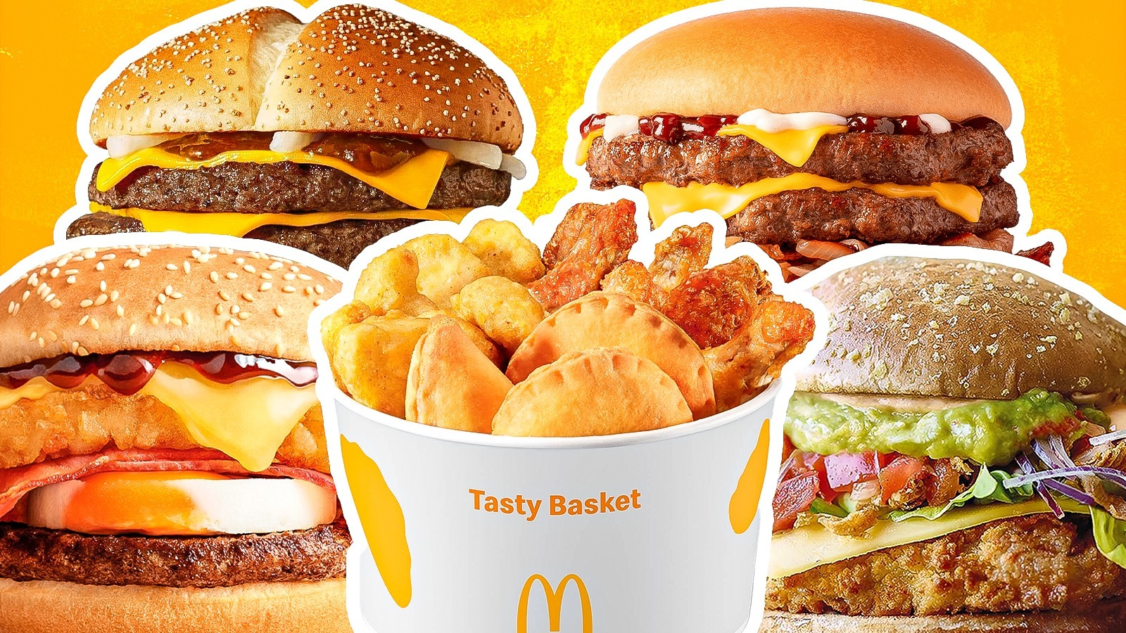
Action Plan for Implementation
Goal 1: Create a unique menu
Form a multidisciplinary team to create innovative and new menu items which will be more healthier.
To determine how customer requirements and tastes change across various markets through doing market research.
Create new menu items that are more in line with regional cultures and trends, healthier, and more personalised (Serra-Majem et al. 2020).
Introduce new healthy menu items with a consumer-friendly marketing effort that focuses on their advantages.
Goal 2: Enhance the clientele's encounter
Renovate eateries to provide a more contemporary and welcoming atmosphere.
Invest in new equipment to increase order-taking and meal preparation accuracy and efficiency.
To express gratitude to clients for their business, introduce a customer loyalty programme.
Notes:
There must be representation from operations, finance, marketing, and research and development on the team.

Slide 10
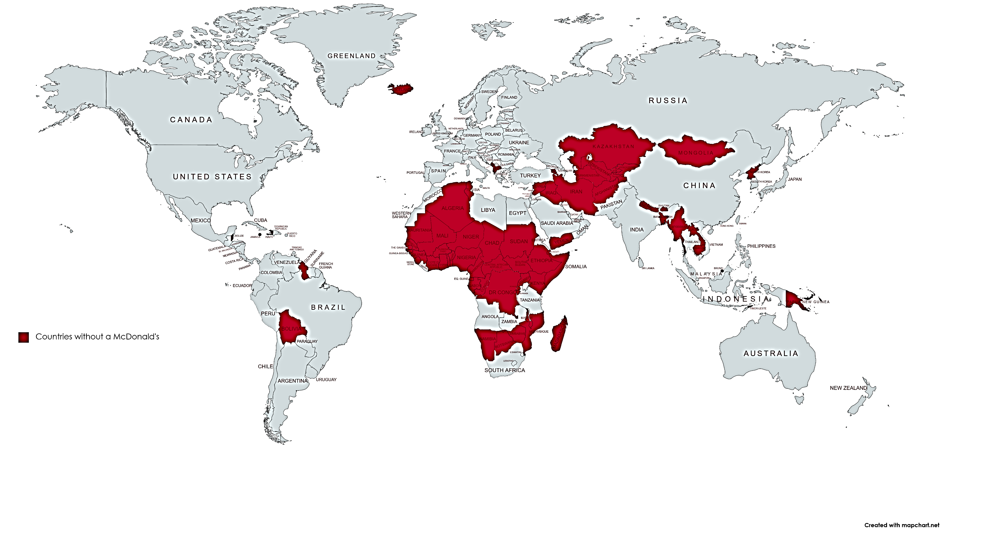
Contd
Timeline
A rough schedule for carrying out the strategic transformation strategy is as follows:
Year 1: Create a cross-functional team, study the market, start creating healthier menu items, and create plans for restaurant renovations.
Year 2: Start renovating eateries and testing healthier menu items in a few markets.
Year 3: Roll out new menu items internationally and complete refurbishment of establishments.
Year 4: Keep experimenting with the menu and enhancing the patron experience.

Slide 11

Strategic Change Management
The process of organising, carrying out, and assessing strategic change is known as strategic change management.
Communication: It is crucial to inform all parties involved employees, clients, and suppliers of the strategy shift (Pasmore et al. 2019).
Resistance to change: Anticipating and addressing resistance is crucial since it is common for people to be resistant to change.
Evaluation: To make sure the strategy change is on track and producing the expected results, it is crucial to track and assess it.
Notes:
Effective strategic change management is essential to achieving the intended results.
This is going to make it more likely that everyone can embrace the change and comprehend it.

Slide 12
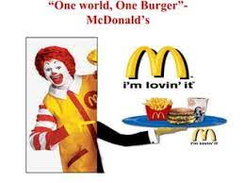
Cross-Cultural Implications
The cross-cultural ramifications of strategy change implementation in a multinational firm must be considered.
As an example, in some cultures, what is seen to be excellent customer service might not be in another.
It is important to customise the strategic transformation strategy to the unique cultural context of every nation (Hanelt et al. 2021).
Notes:
Working with local staff members and consultants can help achieve this.

Slide 13

Conclusion
Enhancing the customer experience is a workable, acceptable, and appropriate strategic change choice for McDonald's global operations.
Additionally, it's a choice that probably helps McDonald's in achieving its aims and objectives.
Notes:
The action plan for putting the selected strategic choice into practice consists of renovating eateries, providing more individualised service, enhancing the standards of the cuisine, growing the delivery services, and making marketing and advertising investments. Effective strategic change management is essential to achieving the intended results. Evaluation, opposition to change, and communication are important factors to consider while managing strategic change.

Slide 14
Reference List
Burton, E.T. and Smith, W.A., 2020. Mindful eating and active living: Development and implementation of a multidisciplinary pediatric weight management intervention. Nutrients, 12(5), p.1425.
Halawa, M. and Parasecoli, F., 2019. Eating and drinking in Global Brooklyn. Food, Culture & Society, 22(4), pp.387-406.
Hanelt, A., Bohnsack, R., Marz, D. and Antunes Marante, C., 2021. A systematic review of the literature on digital transformation: Insights and implications for strategy and organizational change. Journal of Management Studies, 58(5), pp.1159-1197.
Kraak, V.I., Rincón‐Gallardo Patiño, S. and Sacks, G., 2019. An accountability evaluation for the International Food & Beverage Alliance's Global Policy on Marketing Communications to Children to reduce obesity: A narrative review to inform policy. Obesity Reviews, 20, pp.90-106.
Pasmore, W., Winby, S., Mohrman, S.A. and Vanasse, R., 2019. Reflections: sociotechnical systems design and organization change. Journal of Change Management, 19(2), pp.67-85.
Raheem, D., Shishaev, M. and Dikovitsky, V., 2019. Food system digitalization as a means to promote food and nutrition security in the barents region. Agriculture, 9(8), p.168.
Serra-Majem, L., Tomaino, L., Dernini, S., Berry, E.M., Lairon, D., Ngo de la Cruz, J., Bach-Faig, A., Donini, L.M., Medina, F.X., Belahsen, R. and Piscopo, S., 2020. Updating the mediterranean diet pyramid towards sustainability: Focus on environmental concerns. International journal of environmental research and public health, 17(23), p.8758.
Tien, N.H., Dana, L.P., Jose, R.J.S., Van Dat, N. and Duc, P.M., 2020. Analysis of McDonalds’ entry strategy into Vietnam market. International journal of advanced research and development, 5(3), pp.23-29.
Dsm, 2022. Better-for-you products with no room for compromise. Available at: https://www.dsm.com/food-beverage/en_US/insights/insights/consumer-insights/health-conscious-consumers-are-looking-to-enjoy-it-all.html# [Accessed on: 10th November 2023]

